Slide 1
How does a bike-share navigate speedy success?
Apirl.2022 Tzu Han Hsu

Slide 2
Abstract of the case
Cyclistic, a bike-share company in Chicago, this is the company I’m working as a junior data analyst working in the marketing analyst team.
Although the pricing flexibility helps Cyclistic attract more customers, the director of marketing believes that maximizing the number of annual members will be key to future growth.
Cyclisitc’s finance analysts have concluded that annual memebers are much more profitable than casual riders.

Slide 3
Rather than creating more marketing campaign that targets all-new customers, the director of marketing believes there is a very good chance to convert casual riders into members.
To design a new marketing strategy to convert casual riders into annual members, our team needs to better understand…
How annual members and casual riders differ?(This case study in focusing on.)
Why casual riders would buy a membership?
How digital media could affect their marketing tactics?

Slide 4
About the dataset
The data we are using for this analysis is collected by Divvy system, which is owned by the city of Chicago.
The Divvy system is operated by third party(Bikeshare), and was permitted by the city of Chicago to share partial data to public for research.
Although the data was collected from 2013 till now, we will only be using the recent 3 months for data analysis, due to device frequent exception while processing.

Slide 5
How
do annual members and casual riders use Cyclistic bikes differently?

Slide 6
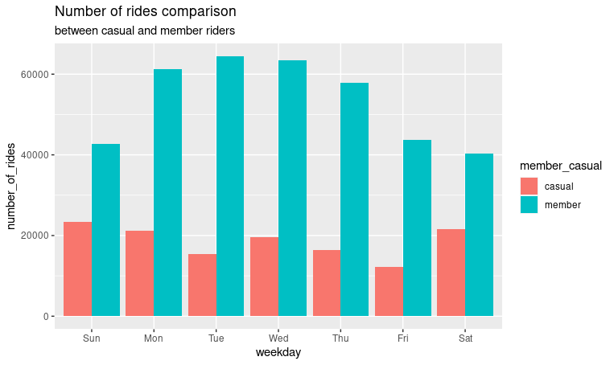
The difference of how often they take on rides
Members tends to take more rides than casual riders.
For the members, the rides are mostly taken during weekdays.
Whereas casual riders tends to take more rides during weekends.

Slide 7
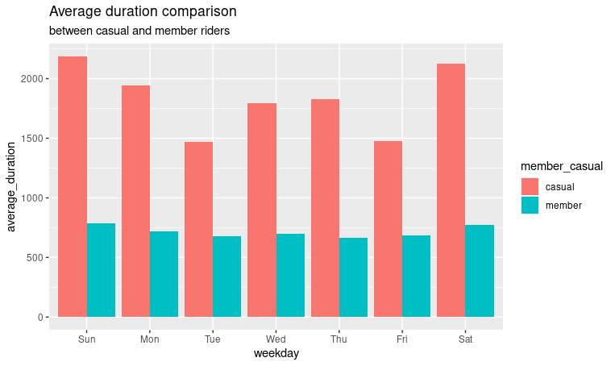
The difference of how much time they spent on rides
Casual riders tends to spend more time while taking rides.
For the casual riders, the longer durations are landing in weekends.
Whereas the trends of the members’ duration are smoothly even if it’s weekend.

Slide 8
Conclusion

Slide 9
Main difference between
casual riders
and members.
Casual riders tends to ride for longer period sometimes,
and members tends to ride ride for a shorter period frequently.

Slide 10
To Convert
casual riders
to members
Encourage casual riders to increase the number of rides.
Price modification for weekend casual users.
Set a restriction on riding duration and number of rides for casual passes.
Since the casual riders are speding more time on the rides…

Slide 11
Recommedation 1:
Create
a new program
for casual riders.
Once the casual riders achieved the target ride of length, they get to
join membership at lower cost or free of charge.

Slide 12
Recommedation 2:
Modify
the pricing system.
Increase the selling price of one-time pass/ all-day pass during weekends, since casual riders tends to go on rides during weekends.
Moreover, member riders won’t be affected by the price increase, which might trigger casual riders to join membership.

Slide 13
Recommedation 3:
Set limitations
to casual riders,
provide discount
to join membership.
Set limitation to the one-time pass/all-day pass. Limit the numbers of ride and duration in a day.
Once the limitation is stricted, provide re-marketing discount to the casual riders, trigger them to join membership with lower cost.

Slide 14
Thank you

